Slide 1

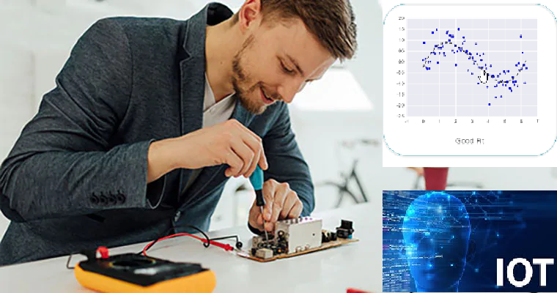



Wearable Devices and Computer Vision
Wednesday, June 24, 2020
Head Instructor: Jose Luis Ramirez Herran
TA’s: Souleymane Konate and Ricardo Villamil

Slide 2

Today’s Lecture
Break
7:40 pm – 7:50 pm
Break
8:40 pm – 8:50 pm
Part 1
Introduction to wearable devices and the SensorTile curriculum
Part 2
Signal Processing
Discussion
Part 3
Homework
Questions?
Projects
Logistics
6:30 pm – 7:30 pm
7:50 pm – 8:40 pm
8:50 pm – 9:30 pm

Slide 3
Break
7:30 pm – 7:40 pm
6:30 pm – 7:30 pm
Part 1
Introduction
Logistics

Slide 4
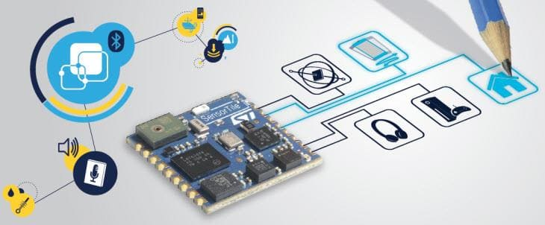
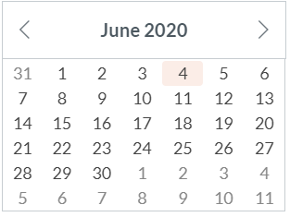
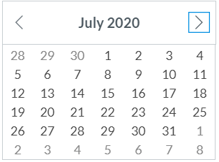
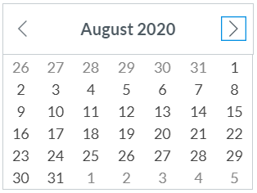
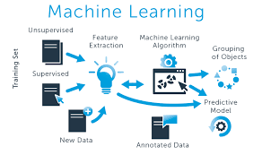
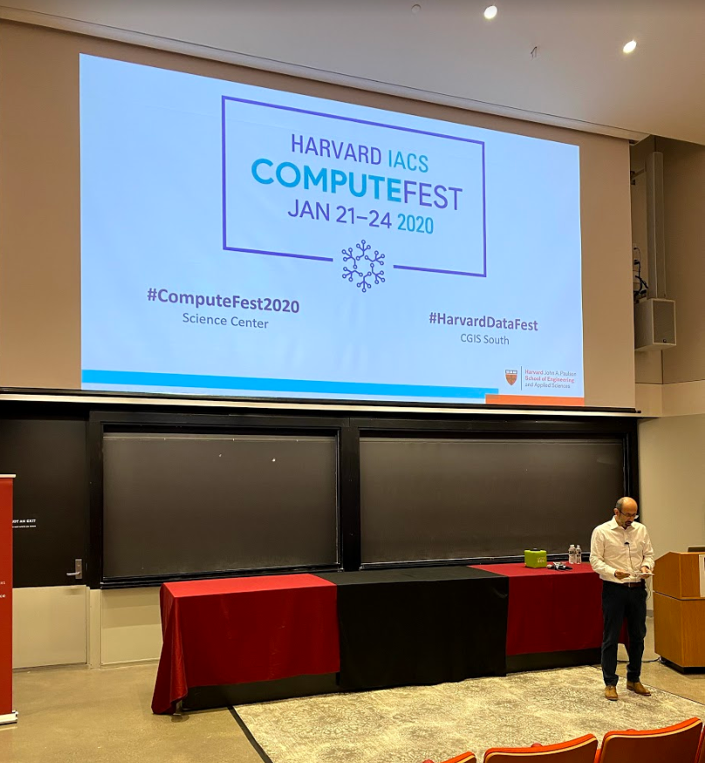
Calendar summer 2020
Mondays and Wednesdays 6:30 pm – 9:30 pm
Wearable Devices and Computer Vision
Project
presentations
Su M Tu W Th F S
SW+HW Setup.+ Basic Tutorials

Slide 5
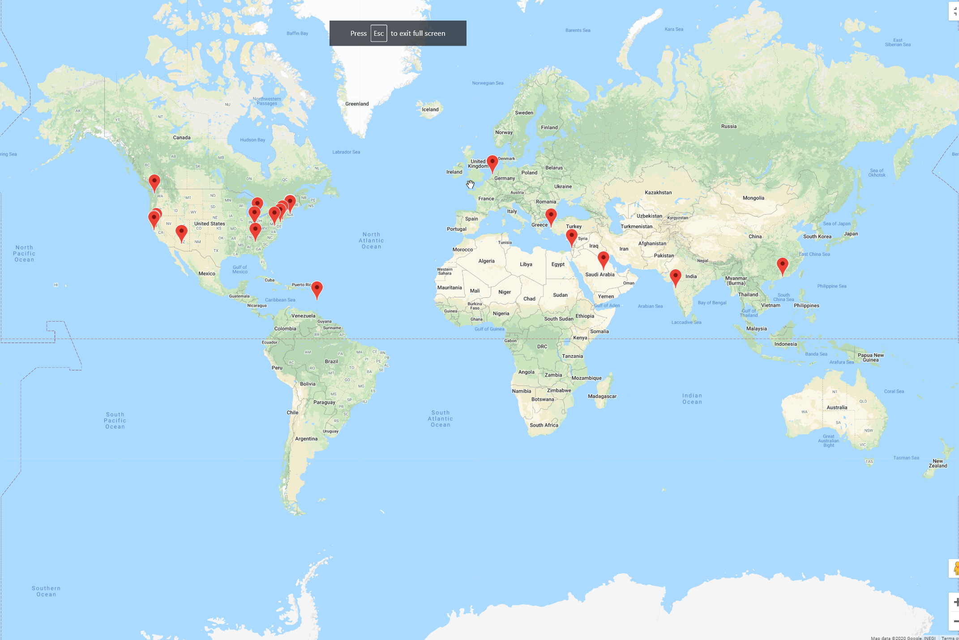
Student Locations
If you haven’t done so already, please take a couple of seconds and submit your location now in Canvas.
Thanks

Slide 6
Piazza
Please sign-up for piazza now.

Slide 7
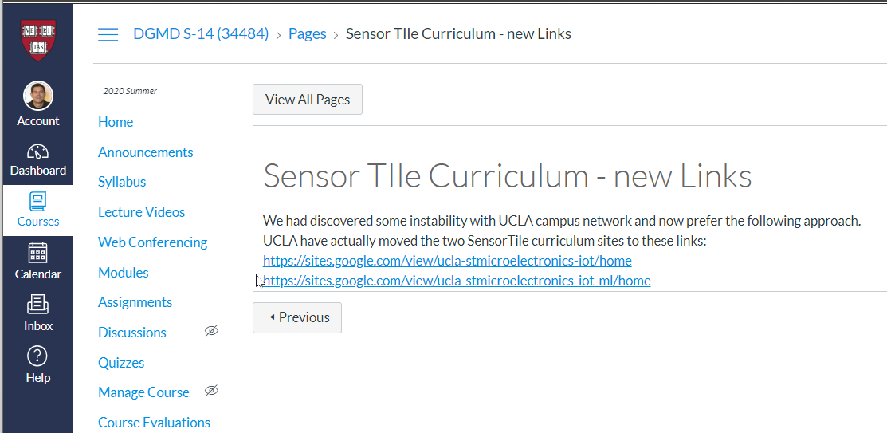
Tutorials: the sensor tile curriculum

Slide 8
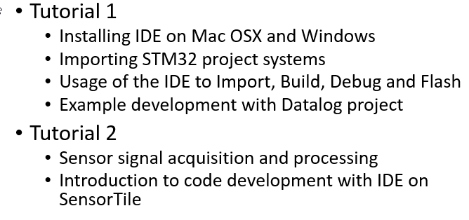

Slide 9
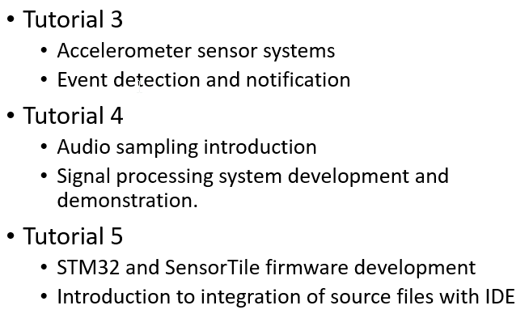

Slide 10
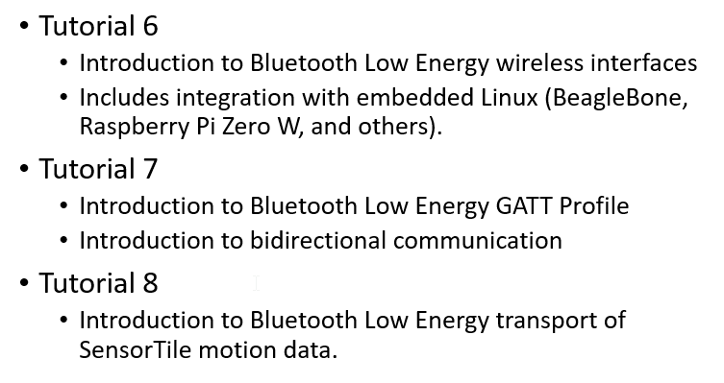

Slide 11
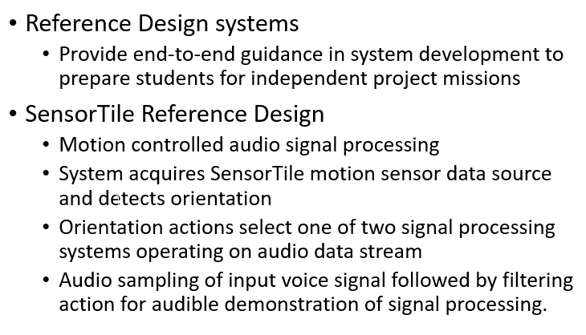

Slide 12
Wearable devices
Apple Watch, Spire, Cartesian vs Polar Coordinates – Anna Barnacka

Slide 13
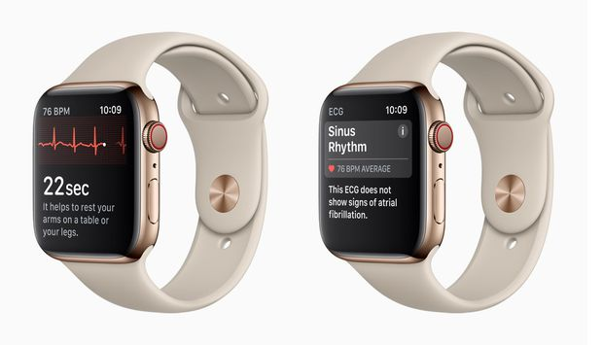
Apple Watch
New Apple Watch:
Heart Rate Monitoring
ElectroCardioGram (ECG) - Detecting Heart Arrhythmias
Fall Detection

Slide 14
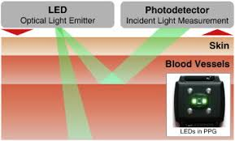
How Watches Measure Heart Rate
Technology: Photoplethysmography (PPG)
PPG makes uses of low-intensity infrared (IR) light. When light travels through biological tissues it is absorbed by bones, skin pigments and both venous and arterial blood.
Since light is more strongly absorbed by blood than the surrounding tissues, the changes in blood flow can be detected by PPG sensors as changes in the intensity of light.
The voltage signal from PPG is proportional to the quantity of blood flowing through the blood vessels. Even small changes in blood volume can be detected using this method.

Slide 15
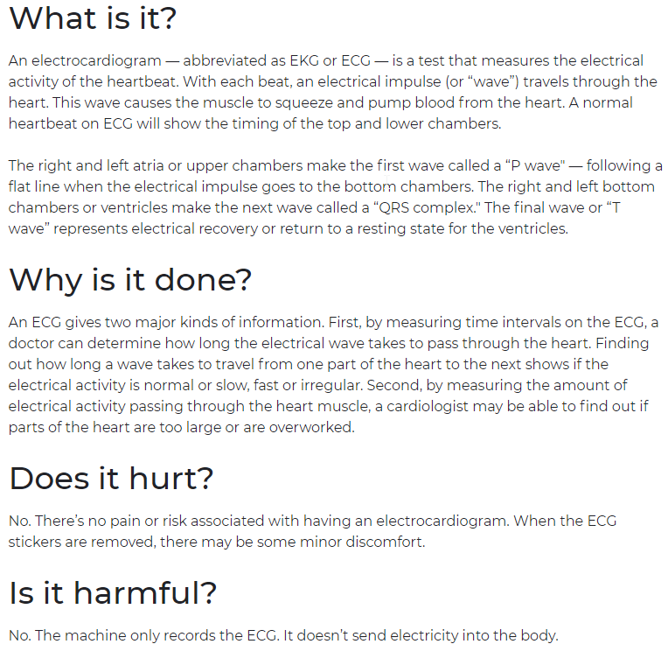
Electrocardiogram (ECG or EKG)

Slide 16
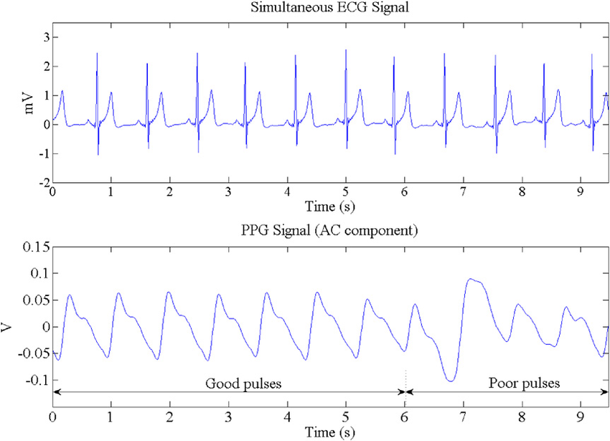
PPG vs ECG
Simultaneous ECG and PPG signal, from received infrared light intensity. The PPG is contaminated with movement artifact after 6 s.

Slide 17
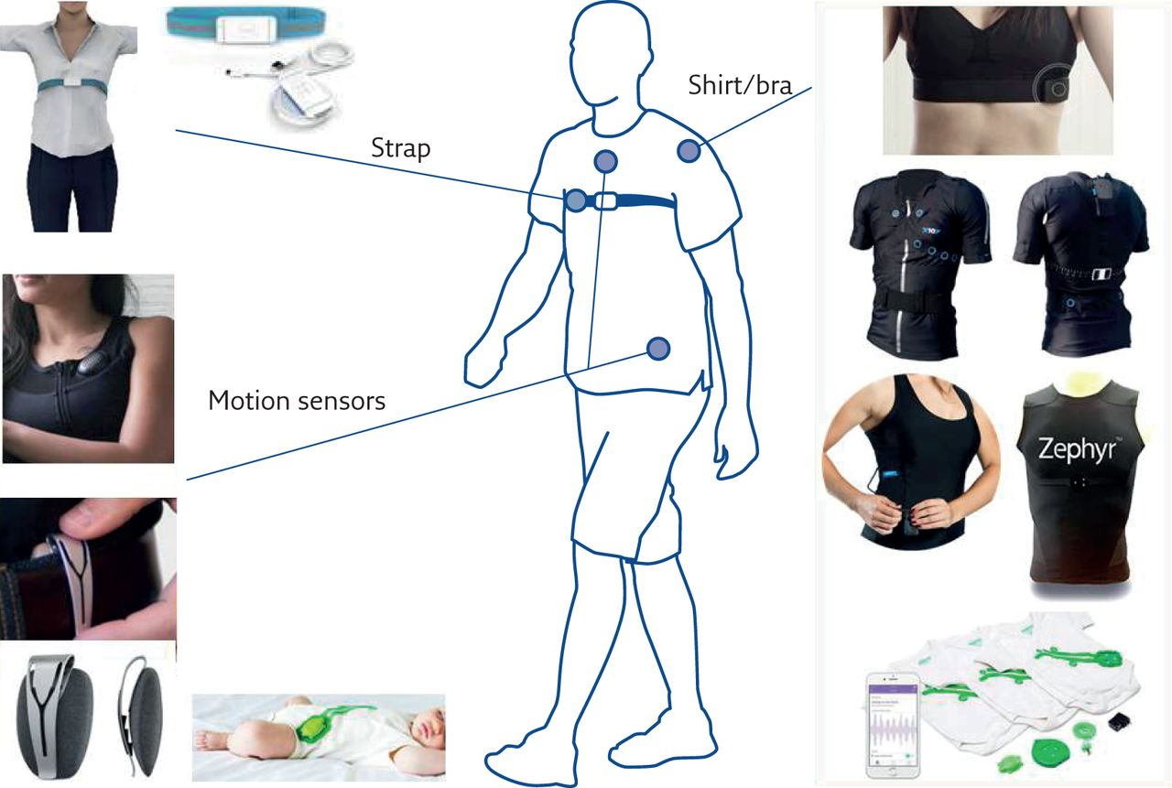
Breathing - Motion Sensors

Slide 18
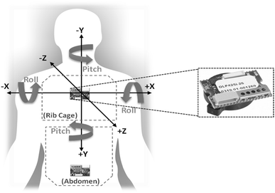
Movement Analysis - Coordinates

Slide 19
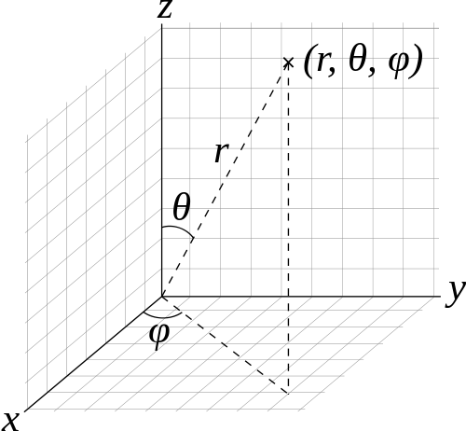
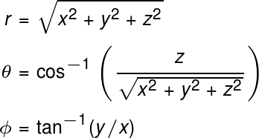
Coordinates - Cartesian vs Polar
Spherical coordinates r, theta (polar angle) and phi (azimuth angle)

Slide 20
Solution: Getting New IDE to Work with Catalina OS
I could not get my projects to compile with my current Catalina IDE setup.
Jose told me to install an older version of Xcode, version 10.3, as my newer version of Xcode was probably creating the conflicts. Right now I am back up and running. This is what I did:
GETTING IDE SYSTEM WORKBENCH TO WORK ON MAC CATALINA: Delete everything and start new. You will need to download an old version of Xcode (10.3) and a fresh install of IDE system workbench from st.com.(STM32CubeIDE:) The links are: Apple developer, download OLD VERSION OF Xcode 10.3: https://developer.apple.com/download/more/?name=Xcode STM32CubeIDE: https://www.st.com/en/development-tools/stm32cubeide.html
1) Delete the Xcode app 2) Delete the IDE app 3) Delete all IDE Workspaces 4) Delete all old project files (except those zipped and renamed) 5) Download Xcode 10.3 (OLD VERSION) from Apple Developer 6) Install Xcode 10.3 7) Download new IDE Workbench STM32CubeIDE from ST.com 8) Install the stlink software that comes with STM32Cube IDE 9) Install IDE STM32Cube 10) Wait for updates 11) Install updates as they appear 12) Restart IDE 13) Import a new workbench project into the new IDE 14) You should see new options: Instead of importing "Existing Projects into Workspace" select "Import ac6 System Workbench for STM32 Project" 15) Follow instructions allowing a conversion process 16) New software popups will appear to allow full conversion process to complete 17) After new software is installed, close IDE and try again 18) When project is loaded, build all 19) If linker type errors occur, go to Project > Properties > C/C++ Build > Settings > MCU GCC Linker > Miscellaneous > other flags, then type into the box by adding: -u _printf_float 20) Apply and close 21) Build project again. It should now be error free and ready to go. 22) If it's not, keep an eye out for incoming updates.
23) Re-install HomeBrew & ST link using the Terminal (according to instructions in Tutorial 1.)

Slide 21
First week Assignments
For June 28 at Midnight
Quiz on:
Data Collection
Signal Processing
Tutorial 1:
Students who have the equipment already, will try to finish this tutorial.
Students which are waiting for equipment will only submit the questions related with the software setup.
Su M Tu W Th F S
Due midnight

Slide 22
Bonus materials: Videos from summer 2019
As an excellent resource we will provide this year is the access to the Lectures from the summer of 2019.
During that semester, we focused a lot in the details about the software and the tutorials.
The video module is an excellent resource that could help you to answers many questions while you are experimenting with the machine learning embedded system: Sensor Tile. You can do this learning independently at your own pace in your own time-zone.

Slide 23
The Grading is based on the assignments, quizzes, and on your project.
Description | Undergraduate (%) | Graduate (%)
Assignments (Due every week on Sundays at midnight) | 50 | 40
Quizzes (shorter assignments due before our class on Wednesday at 4 p.m.) | 20 | 20
Project | 30 | 40

Slide 24


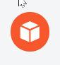
tinyML lifecycle solution transforms developers’ abilities to deploy ML for embedded devices
Collect data: High-quality labeled data is critical for ML analysis. We provide tools and guidance for correct data collection straight from your devices.
Build a model: Combine signal processing, neural networks and anomaly detection to understand the real world.
Deploy and monitor: Deploy models as part of your firmware, monitor model performance in the field, and push updates to devices when you gain more knowledge.

Slide 25
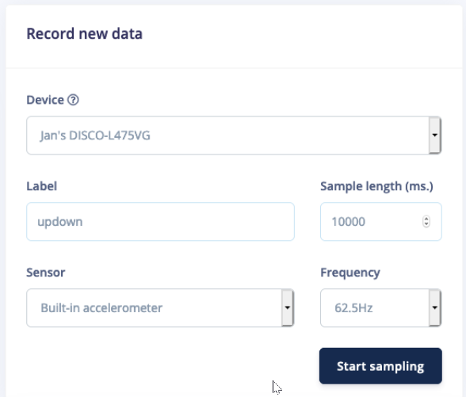
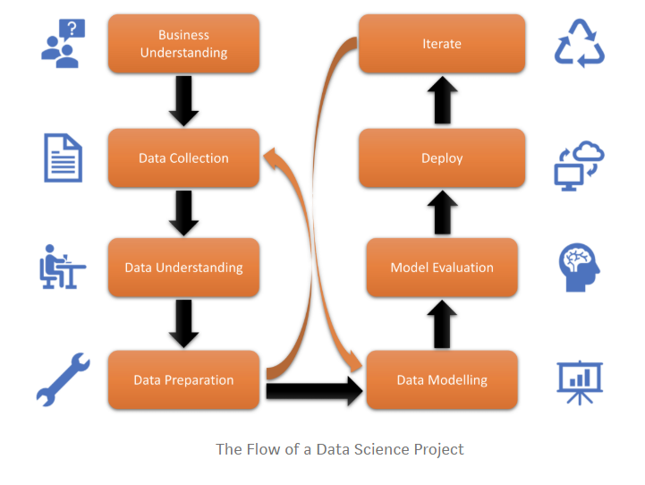
Data collection

Slide 26
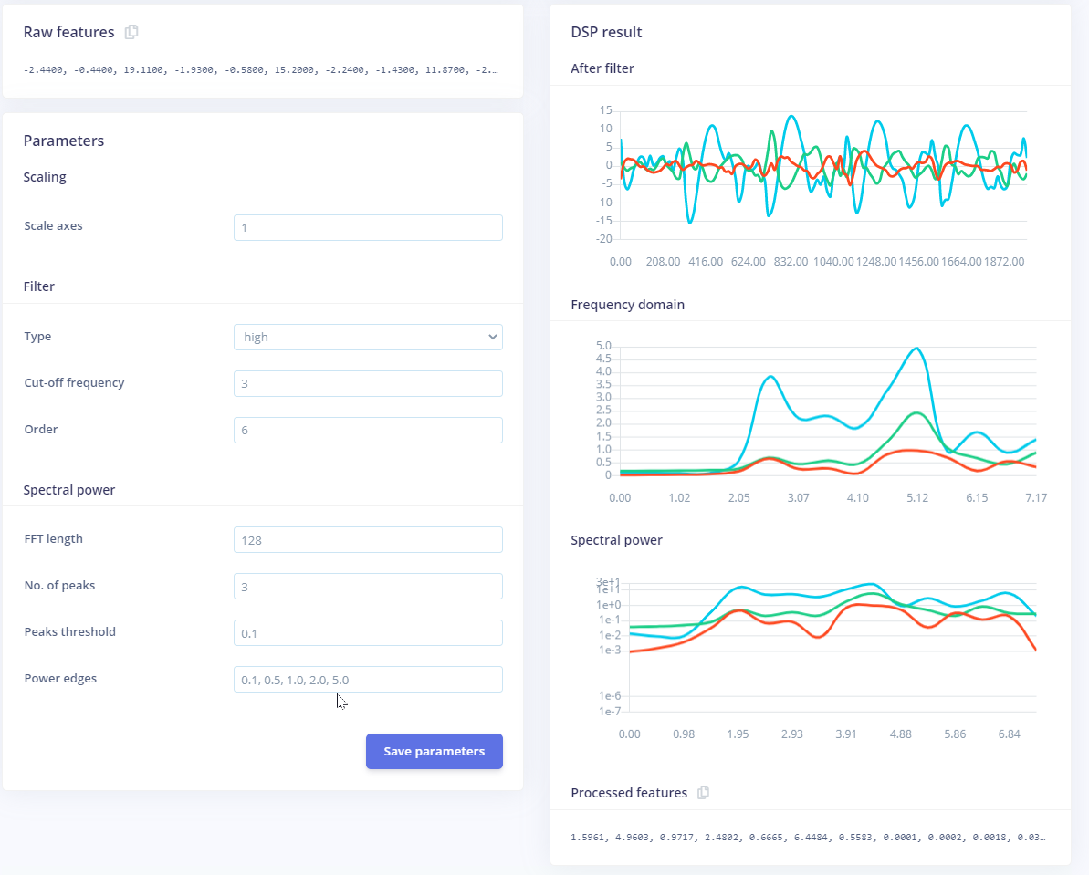
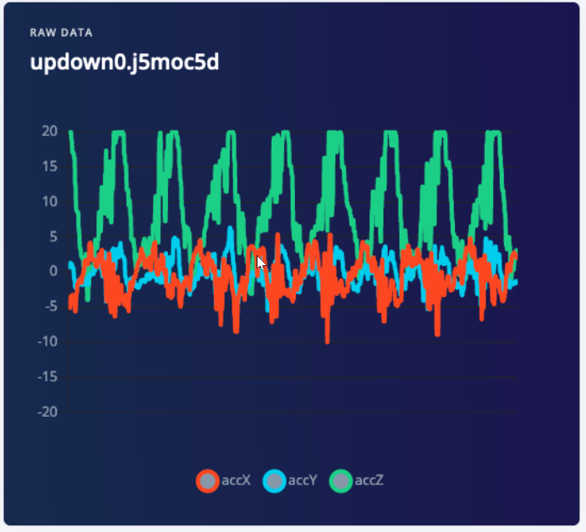
Signal processing

Slide 27
Break
7:40 pm – 7:50pm
Break
8:40 pm – 8:50 pm
6:30 pm – 7:30 pm
7:50 pm – 8:40 pm
8:50 pm – 9:30 pm
Part 1
Introduction
Part 2
Signal Processing
Discussion
Logistics

Slide 28
full group discussion
Make a question in Piazza.

Slide 29
Break
7:30 pm – 7:35 pm
Break
9:10 pm – 9:15 pm
Part 1
Introduction
Part 2
Hands-on Activity
Part 3
Office Hours
Questions?
Discussion
Projects
Logistics
6:30 pm – 7:30 pm
7:35 pm – 8:35 pm
9:15 pm – 9:30 pm

Slide 30
Office hours
emails TA's:
sok462@g.harvard.edu
ricardo_villamil@fas.harvard.edu
Calendly me:
https://calendly.com/jlr682/wearable-devices-final-project

Slide 31
Tutorial 1
Introduction to STMicroelectronics Sensor Tile Development
Environment

Slide 32
Tutorial 1 provides an introduction to the SensorTile platform and its development tools. The steps include:
Installing an Integrated Development Environment (IDE) on a personal computer.
Obtaining reference design example project software. This will specifically include a sensor Data Logging system.
Using the IDE to Import, build, run, debug and flash the SensorTile board to run the example Data Logging project.

Slide 33
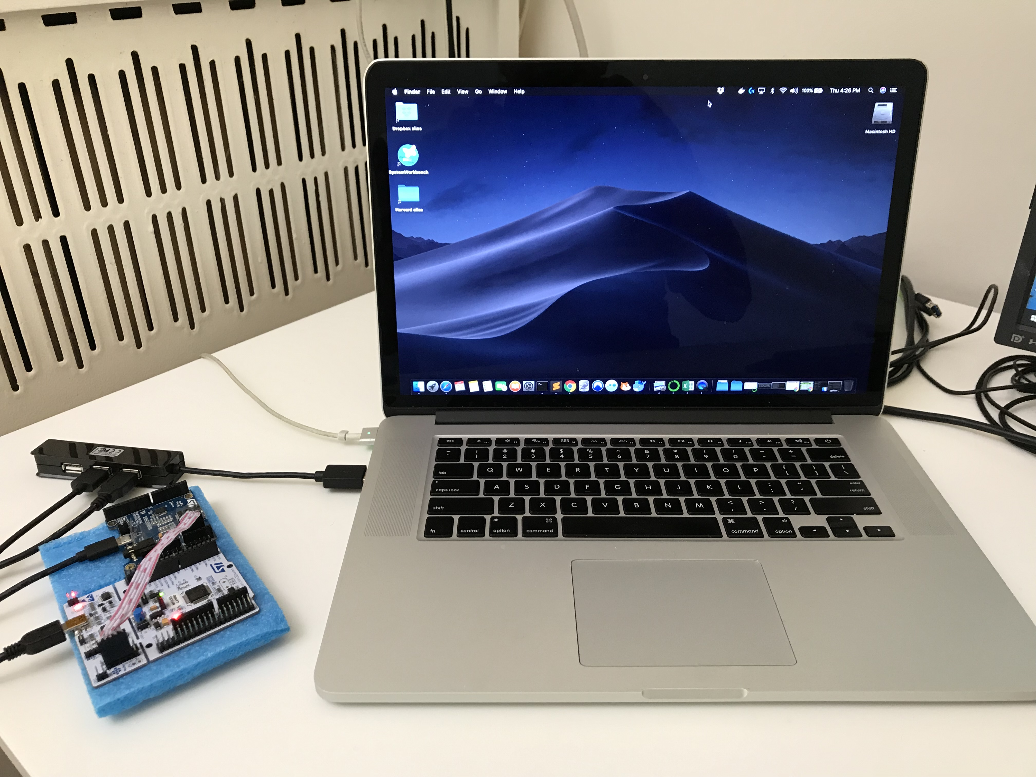
Macbook Pro

Slide 34
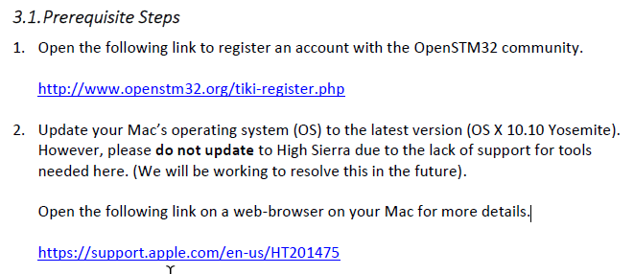
3. Integrated Development Environment Installation

Slide 35
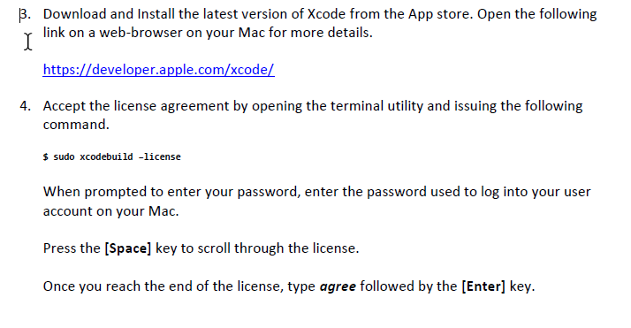
We tested this with Xcode 10 in sierra. You can skip this. There is other ways of accepting license

Slide 36
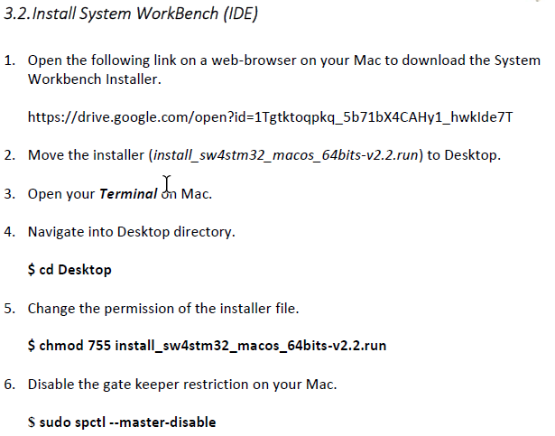
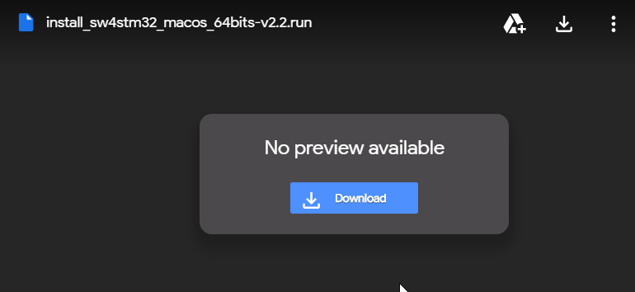
Mine goes to /Downloads

Slide 37
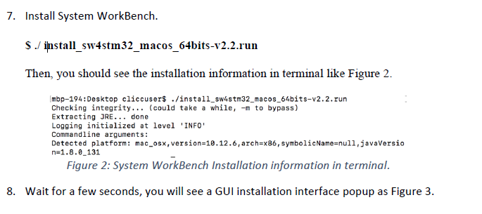

Slide 38
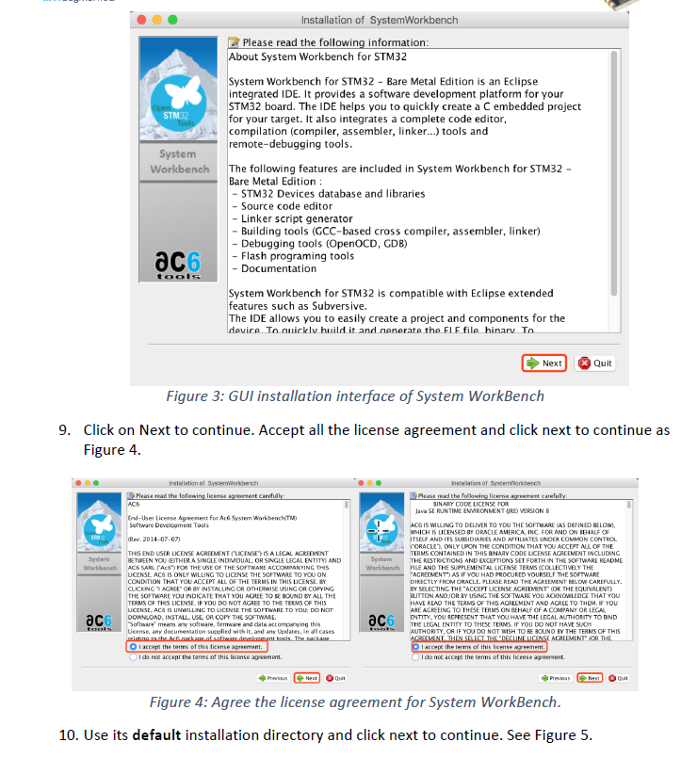

Slide 39
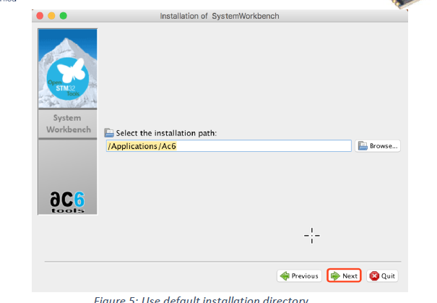

Slide 40
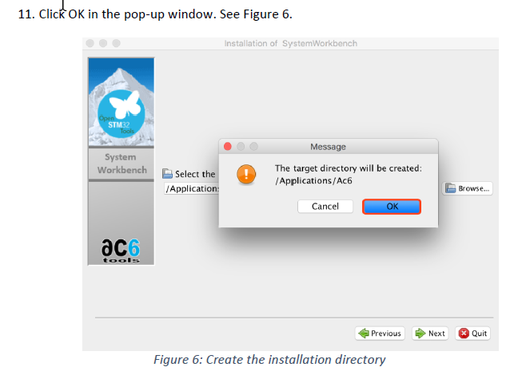

Slide 41
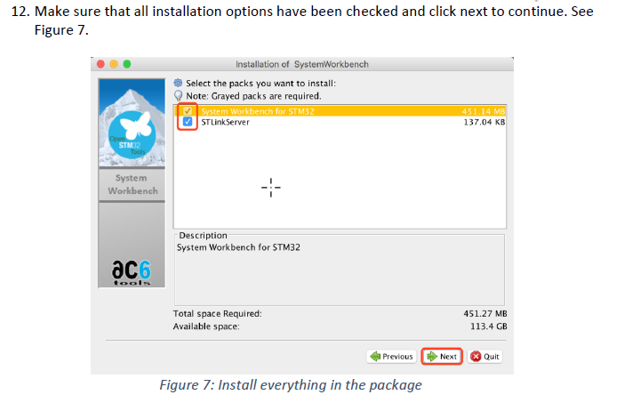

Slide 42
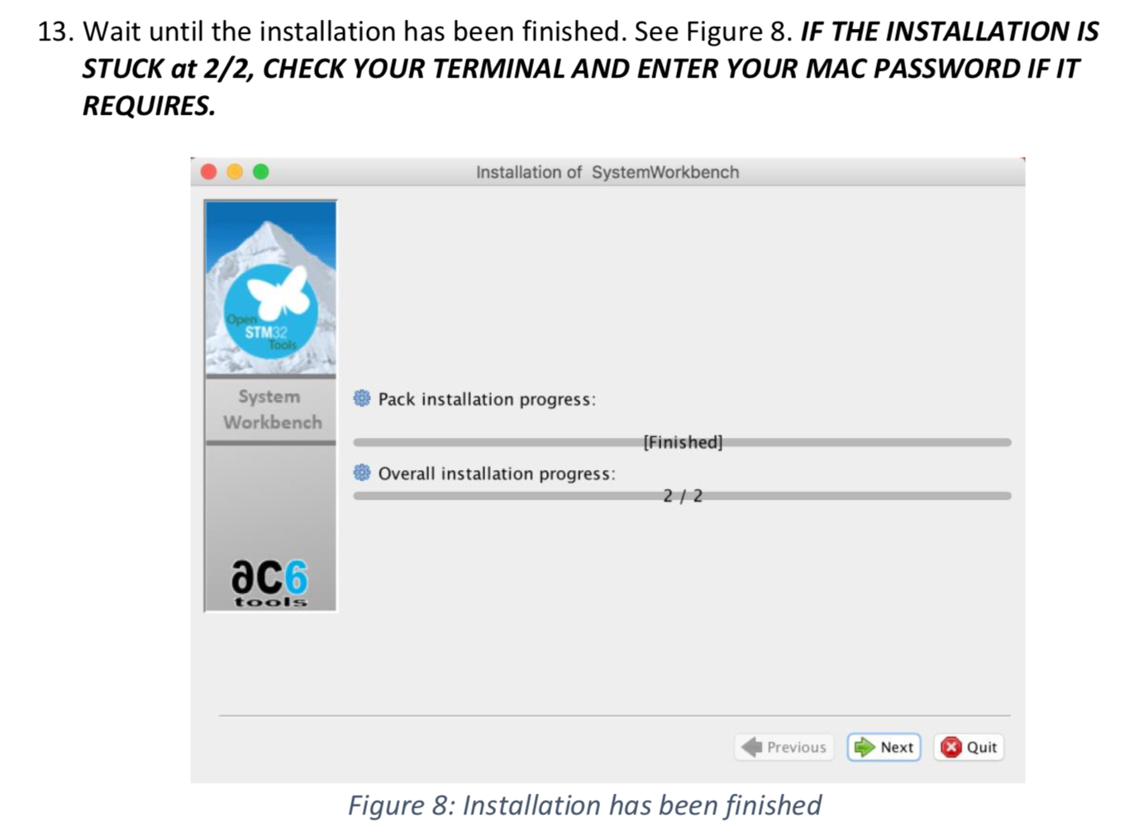

Slide 43
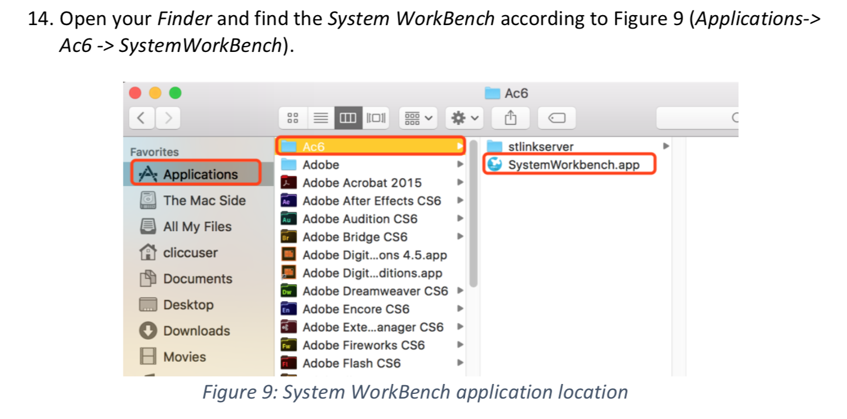

Slide 44
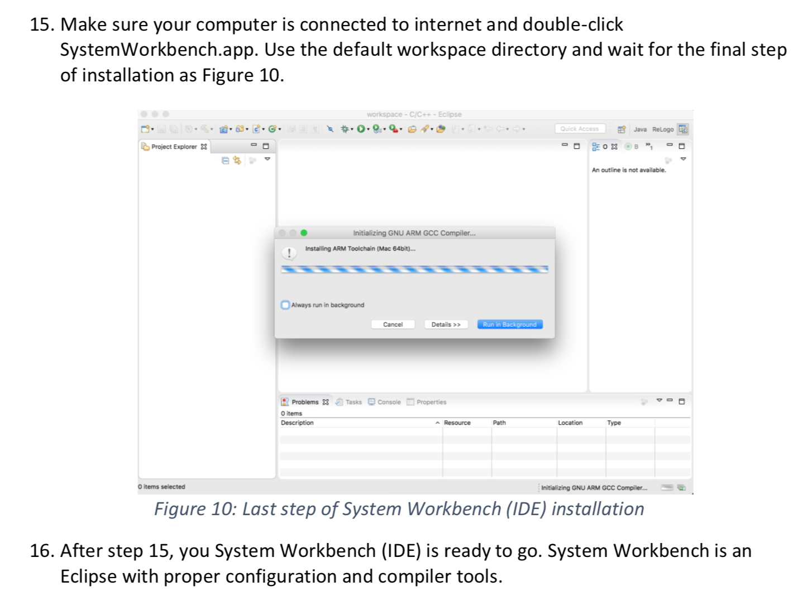

Slide 45
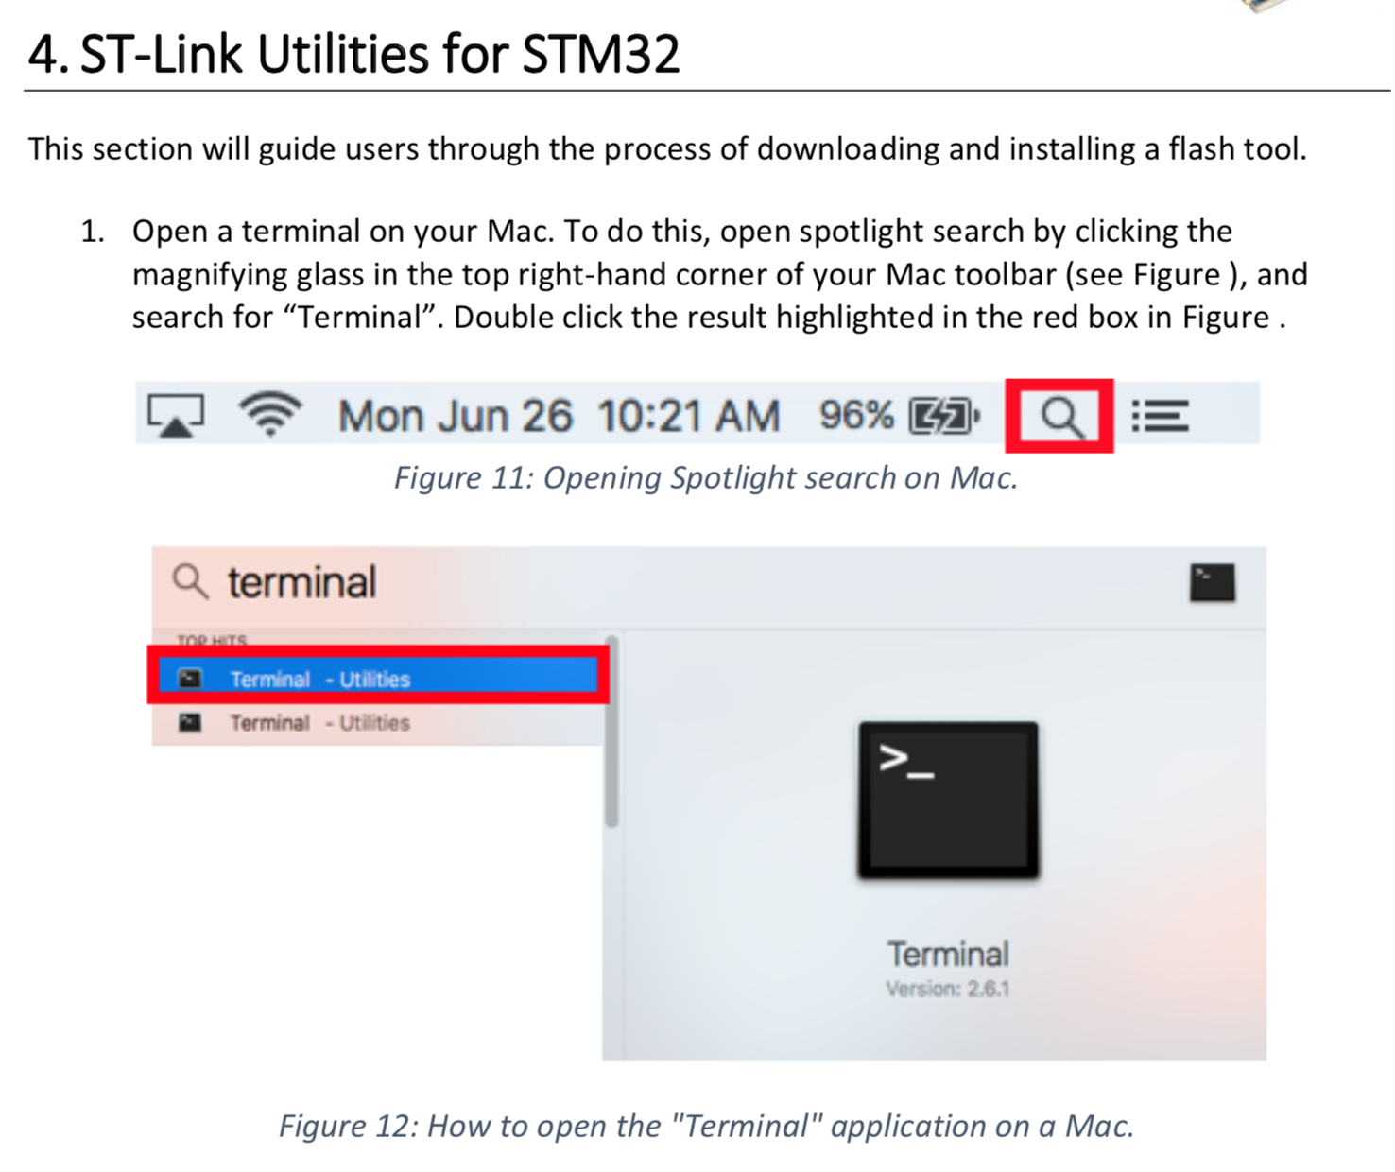

Slide 46
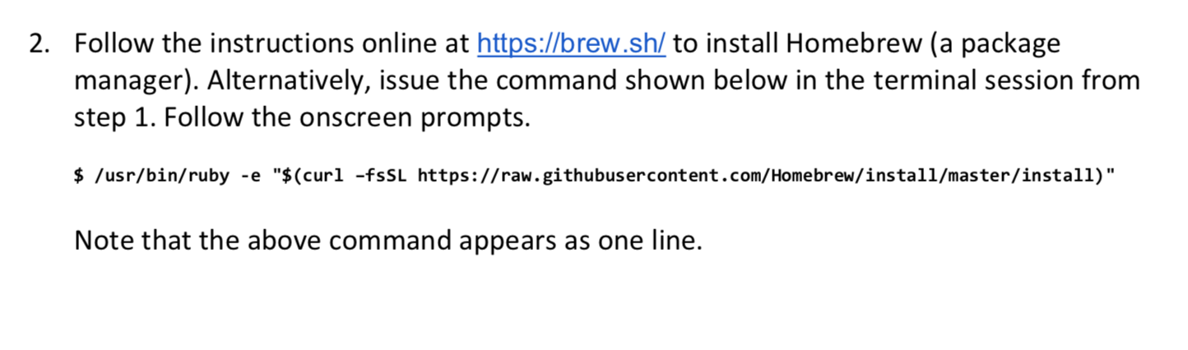
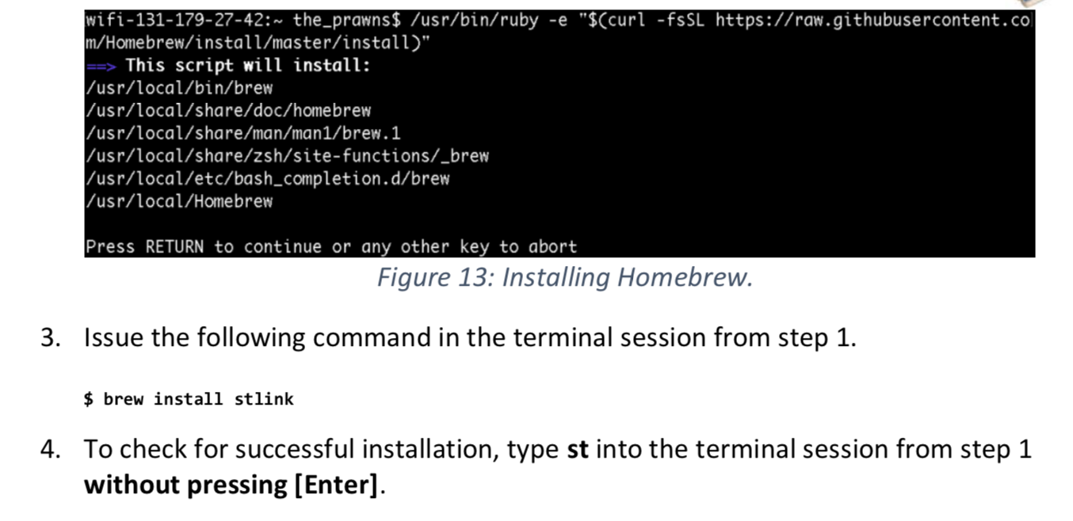

Slide 47
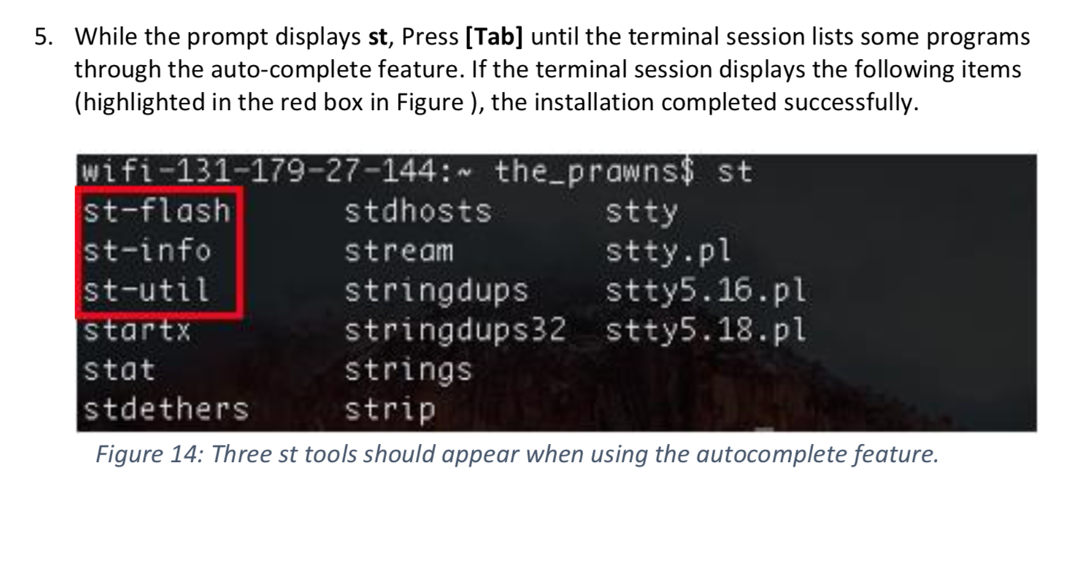

Slide 48
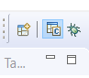
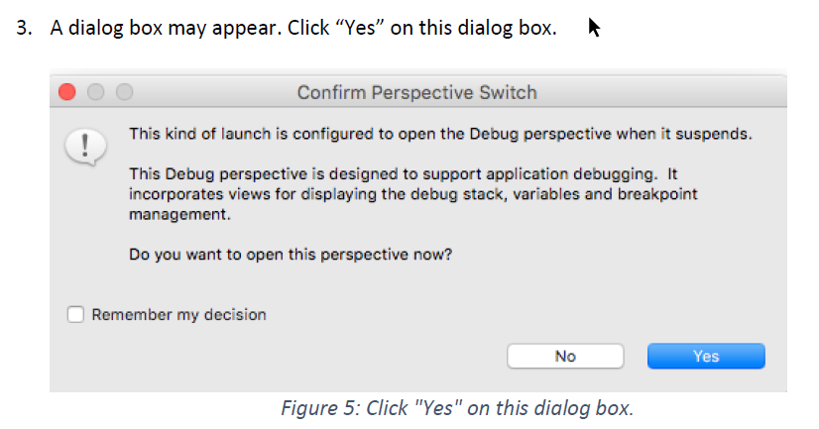
Debug vs C++ perspective

Slide 49
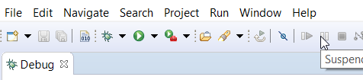
The Resume button in Debug Perspective
RESUME

Slide 50
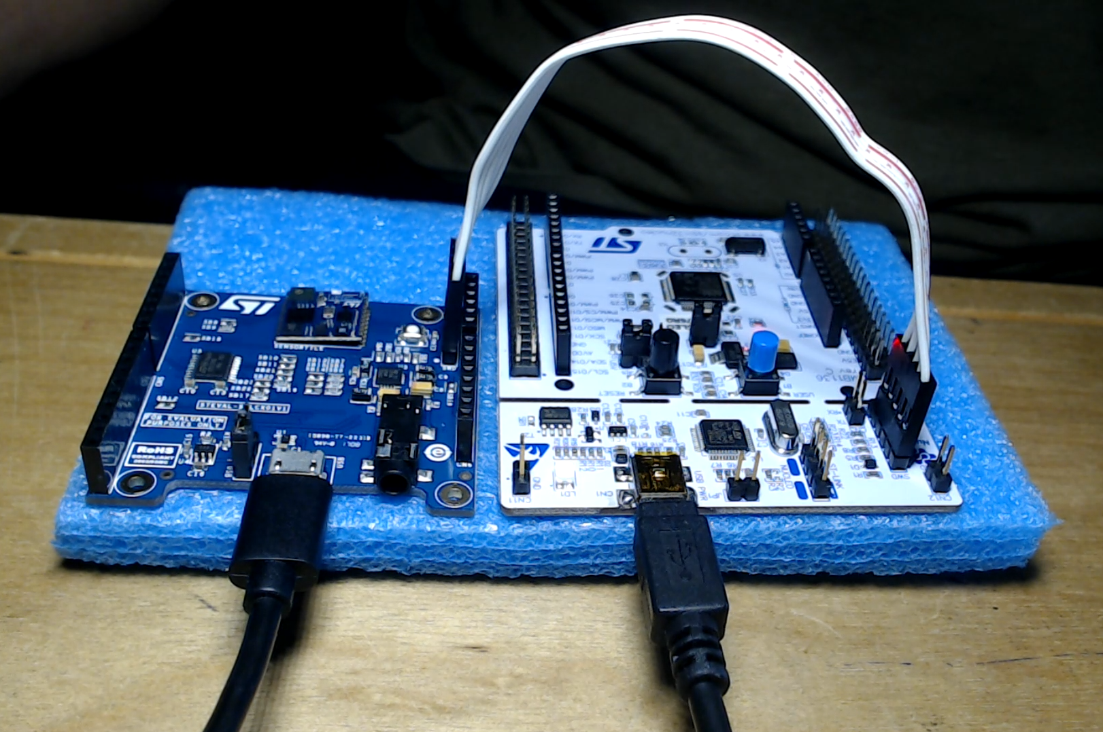
Connection
Serial Wire Debug (SWD)

Slide 51
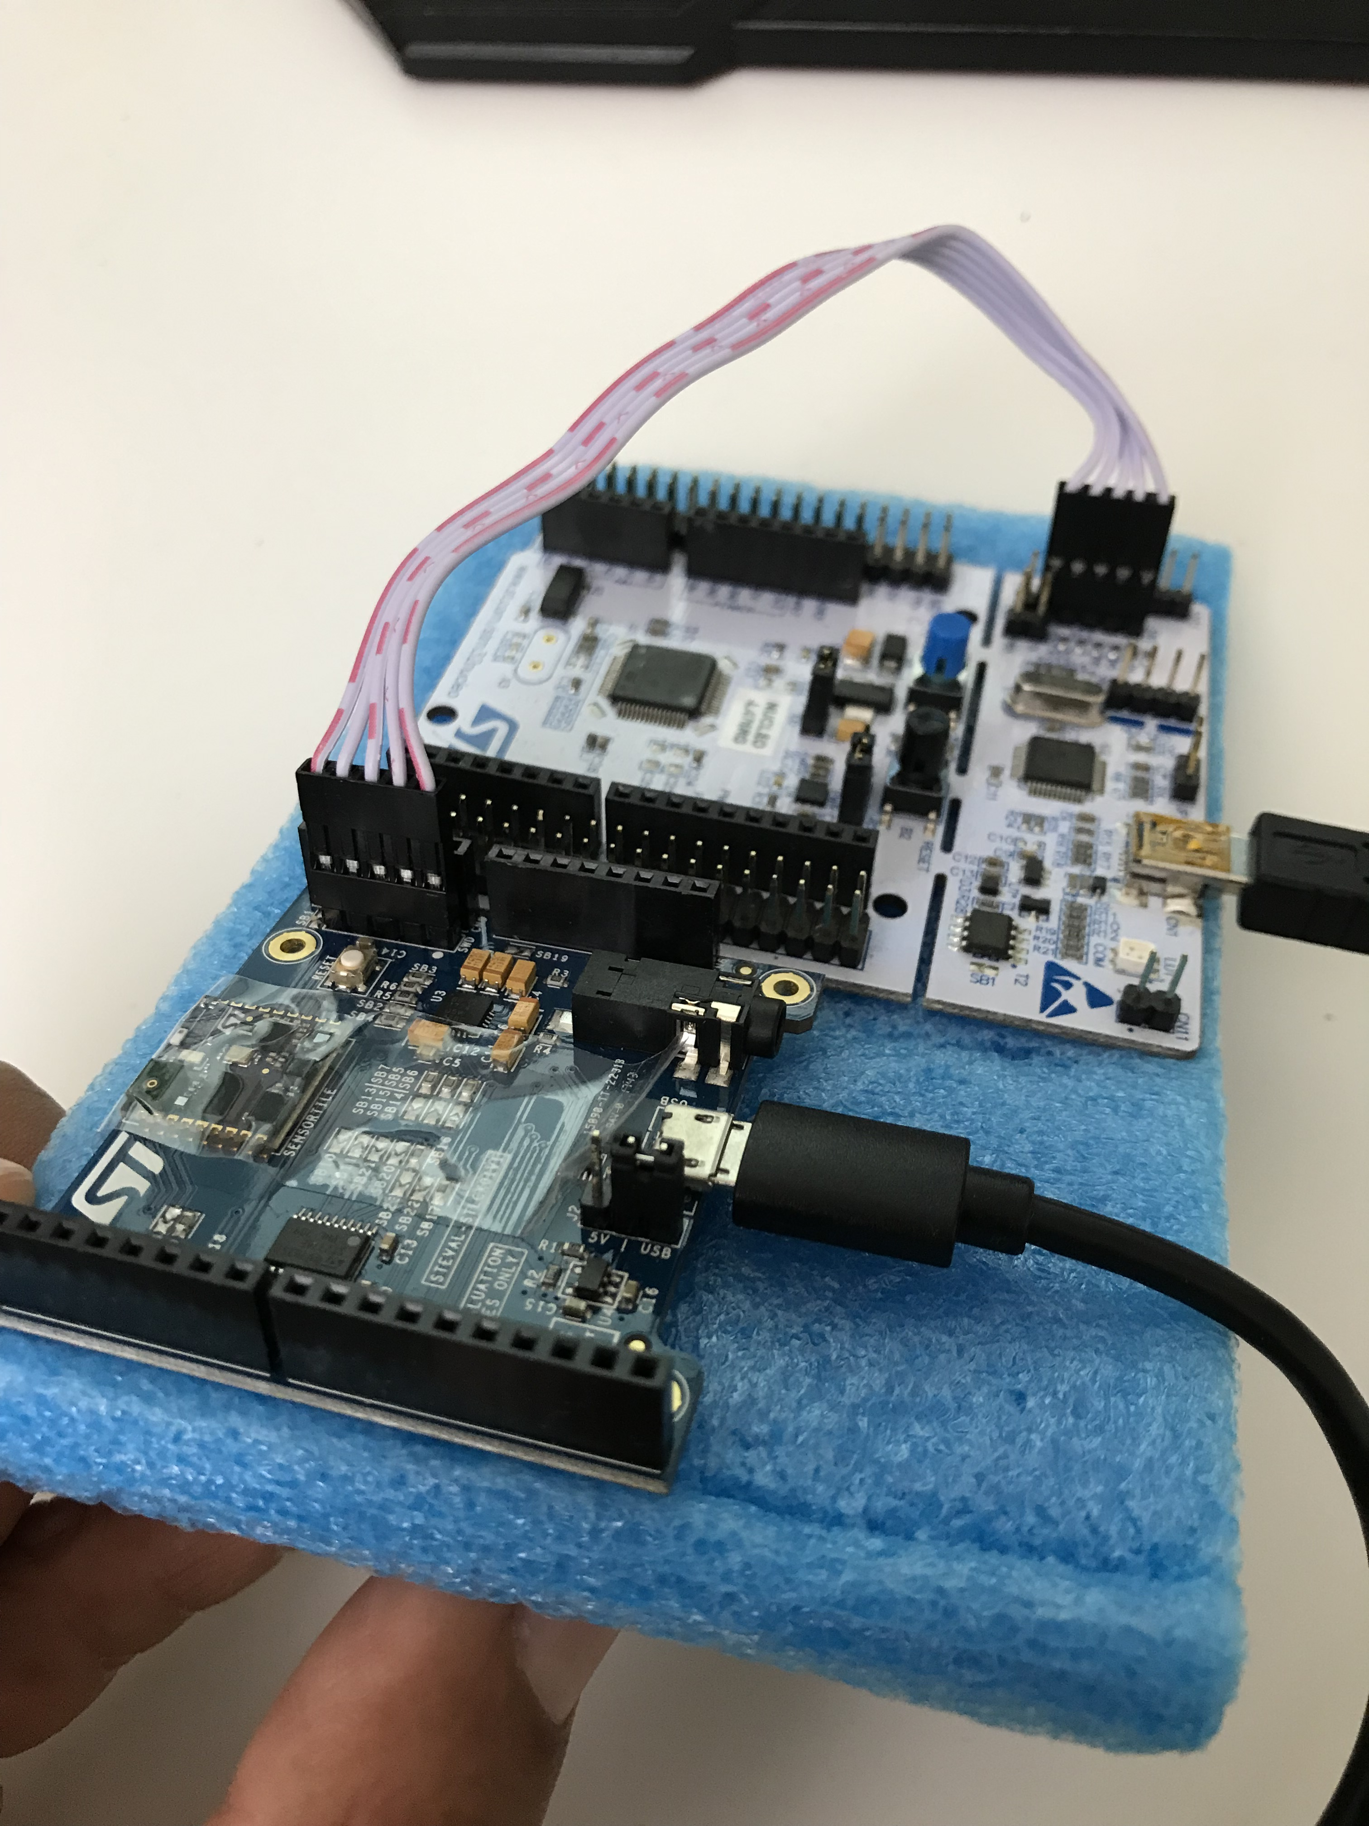

Slide 52
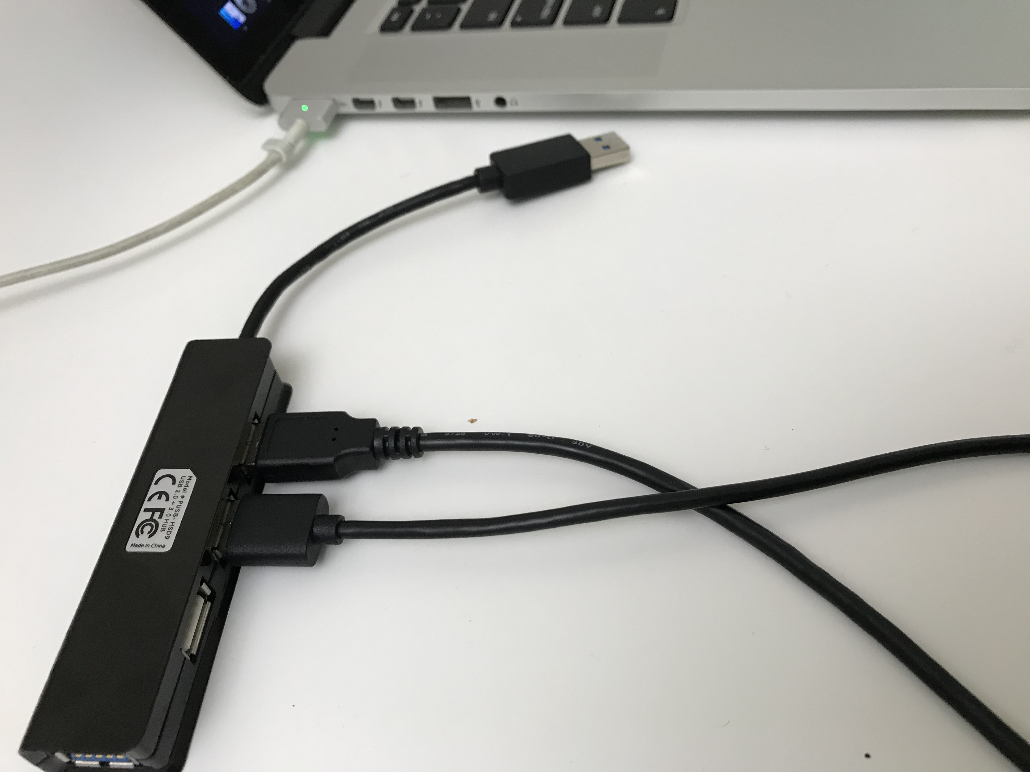

Slide 53
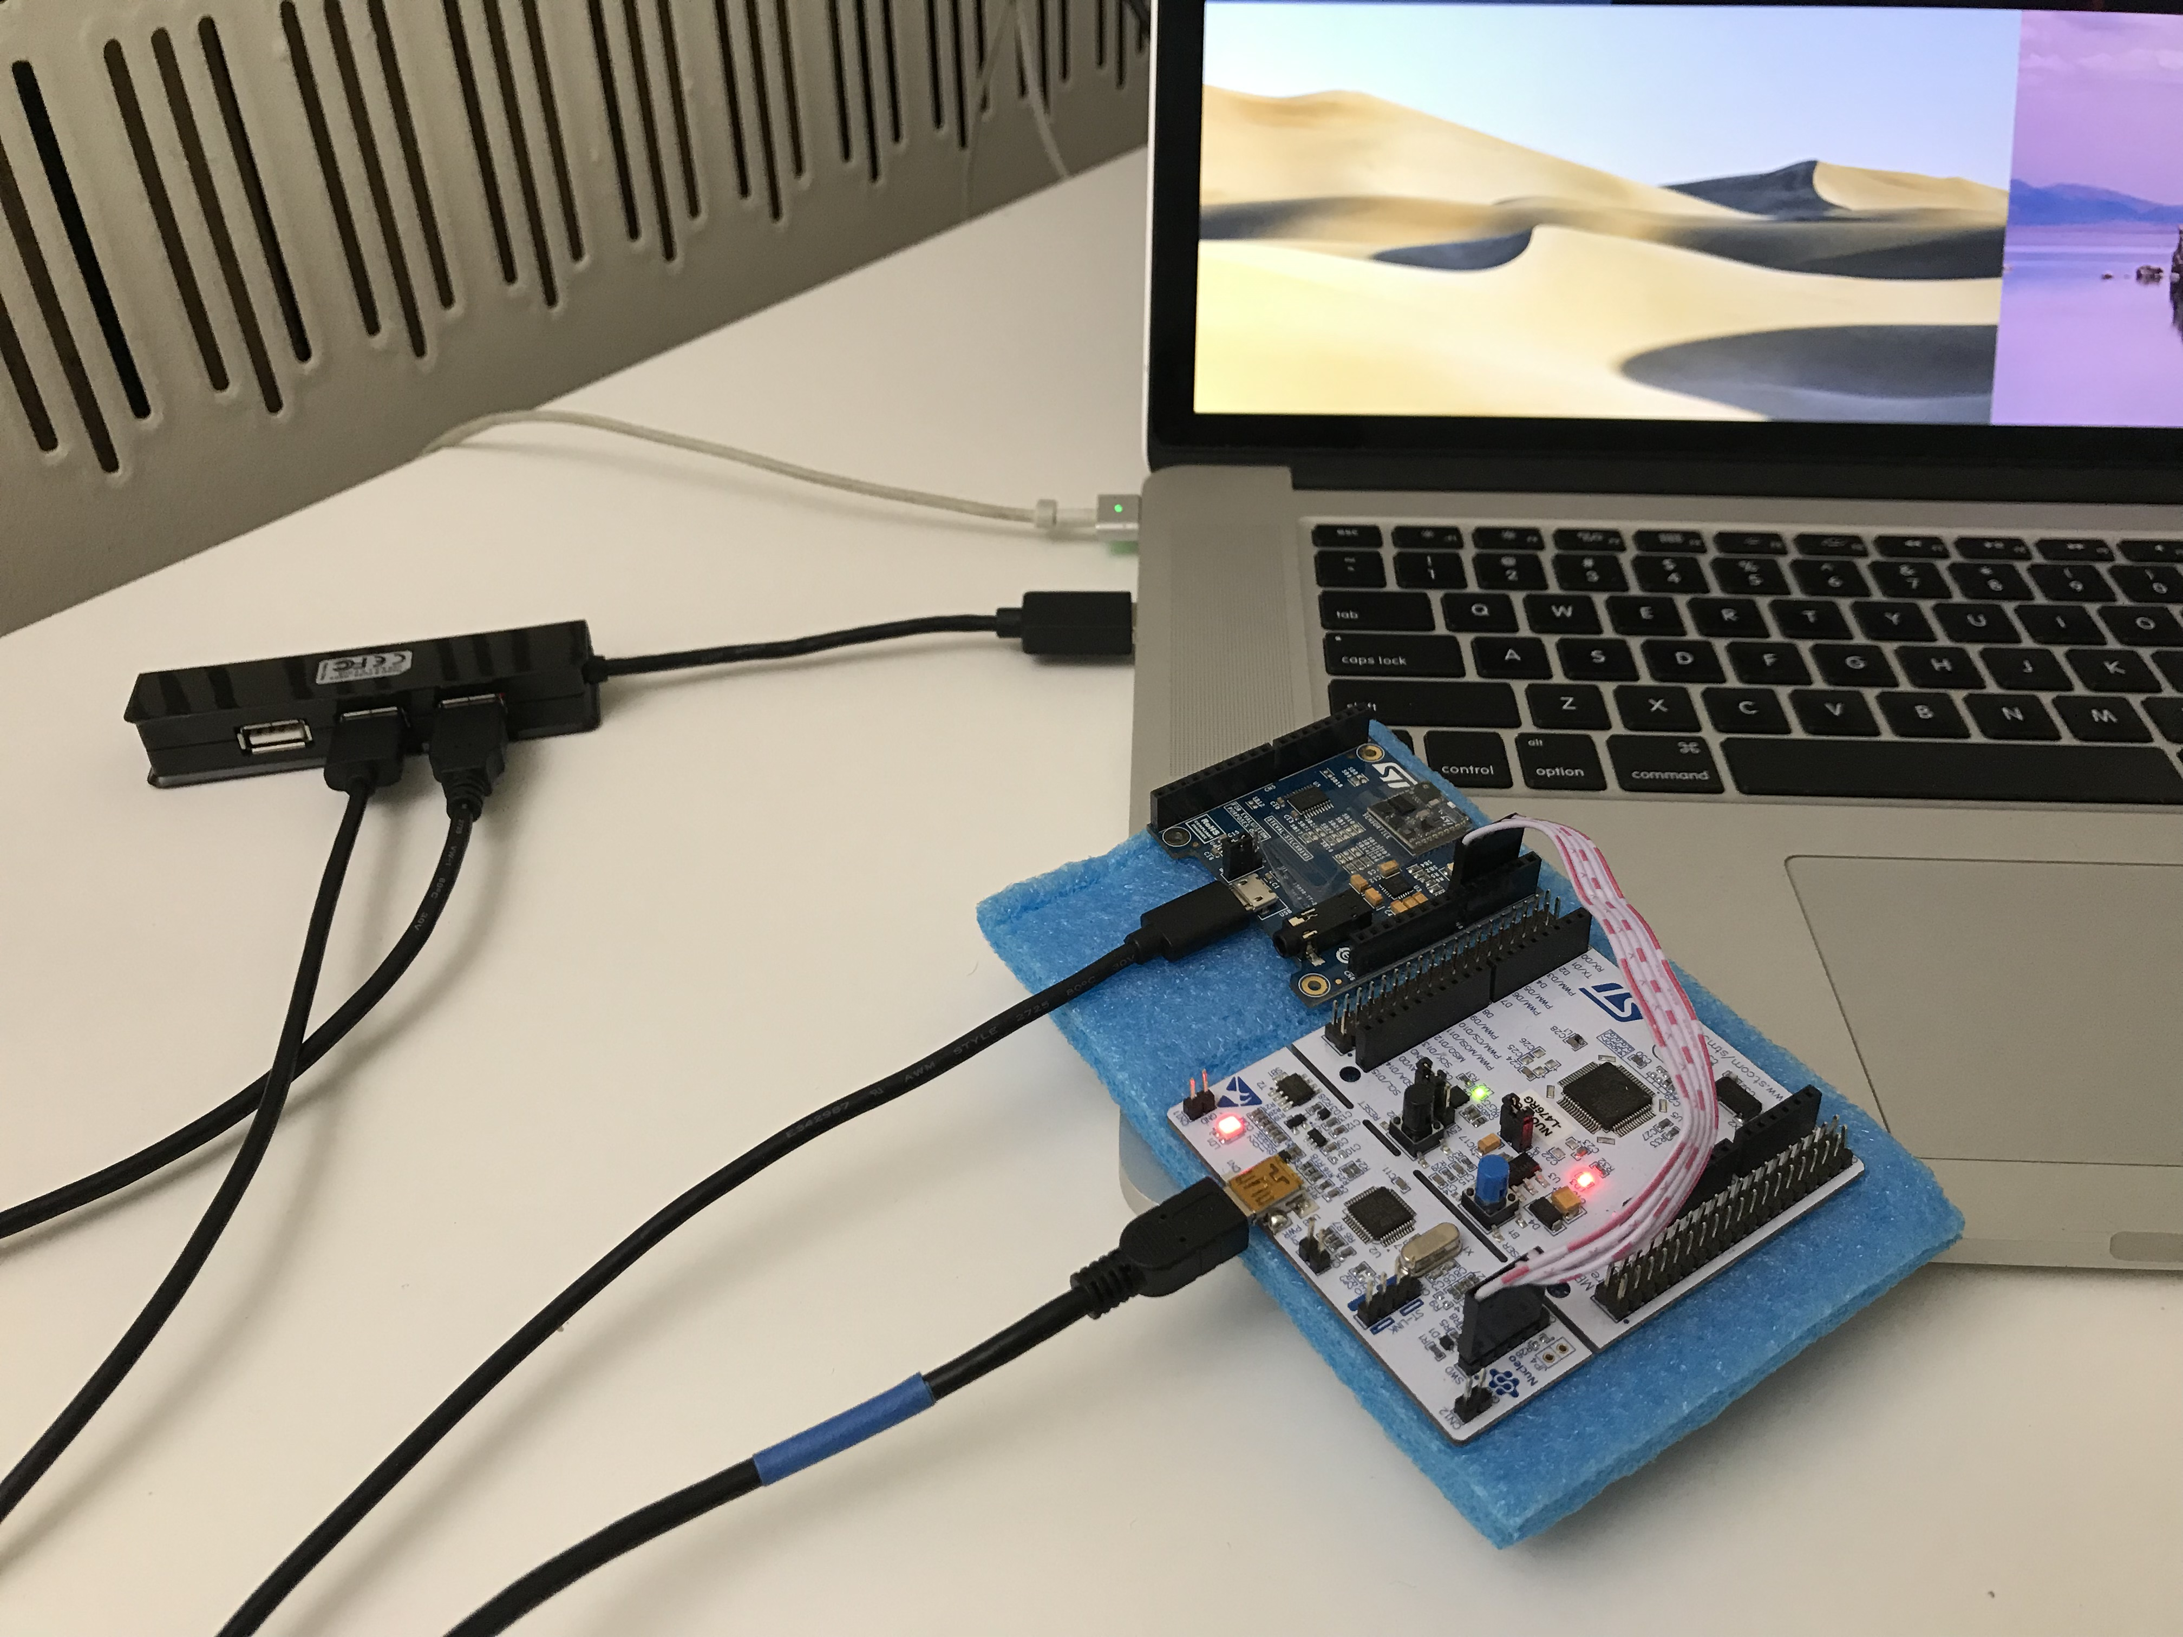

Slide 54


Slide 55
Projects

Slide 56
Student Project Reference Designs
1) STMicroelectronics SensorTile Reference Design: Basketball Freethrow Classifier by Machine Learning 2) STMicroelectronics SensorTile Reference Design: Basketball Hookshot Classifier by Machine Learning 3) STMicroelectronics SensorTile Reference Design: Tennis Motion Classifier by Machine Learning 4) STMicroelectronics SensorTile Reference Design: Resistance Training Motion Classifier by Machine Learning 5) STMicroelectronics SensorTile Reference Design: Climb On: A Climbing Motion Classifier by Machine Learning 6) STMicroelectronics SensorTile Reference Design: Shoulder Rehabilitation Motion Classifier by Machine Learning

Slide 57


Slide 58


Slide 59
Questions?

